Slide 1
Who is buying dental insurance from the health exchanges?
Justin Vena
DS5

Slide 2

Adapting to the changes in the Healthcare Marketplace
ACA (Patient Protection and Affordable Care Act)
Established in 2010, changed the healthcare industry in many different ways.
Introduced the Health Insurance Marketplace (or called the health exchanges)
Health and Dental Products became available for sale in 2013 and came into effect for 2014

Slide 3
Adapting to the changes in the Healthcare marketplace
Insurance Products on the Health Exchange:
Before the Health Exchange was established, most people received their insurance from (1) their employer or (2) buying directly from the insurer.
What types of consumers will buy from the exchanges?
The exchanges make it easy for a consumer to shop around between insurance products.

Slide 4
How will we approach this?
Project Question:
What characteristics can we successfully use to classify which ZIP codes are more likely to buy an ACA dental insurance product?
Let’s gather insurance, Medicare, and Census information to solve this.

Slide 5
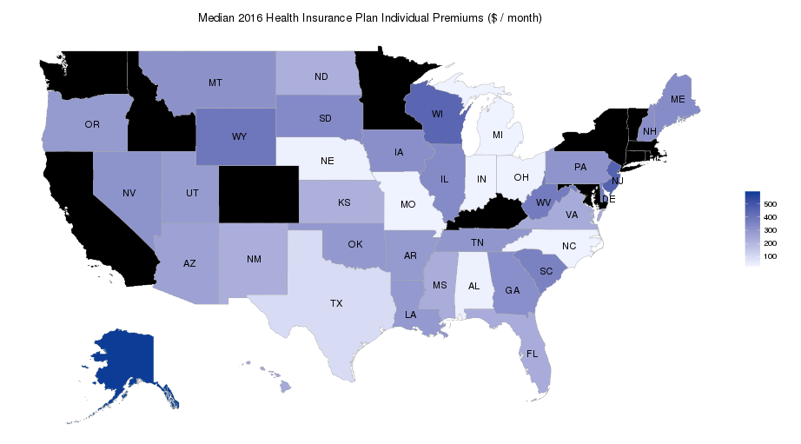
Where’s the Data?
Kaggle.com Health Insurance Marketplace Dataset:
Providing us with the Insurance and Medicare Data
Contains data from 2014 to 2016 from the CMS (Center for Medicare Services)on 35 States (No Washington State)
Several different datasets are included on Kaggle, but will primarily use the Service Area Data

Slide 6
Where’s the Data?
Census.gov’s public data:
2014 ZIP Code/Income data set
Geographical: State, ZIP
Income: Counts by Income Bracket, Average Income

Slide 7
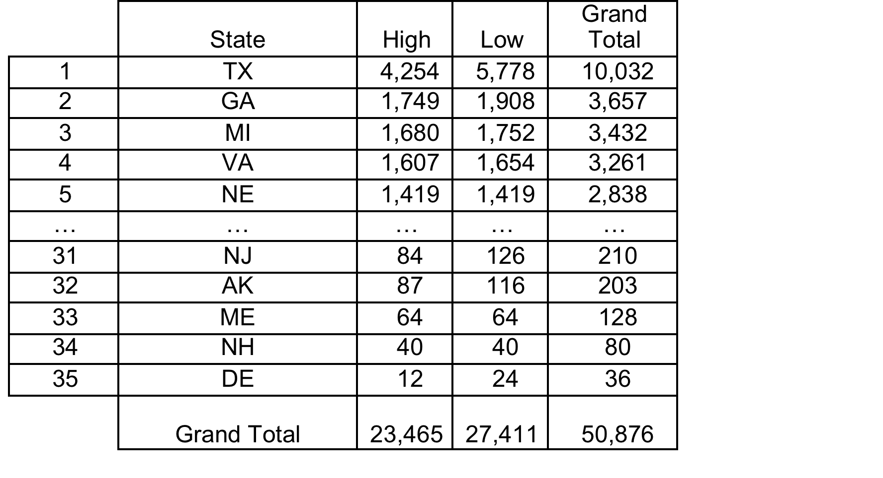
Data Exploration and Investigation
Kaggle Data Features:
Geographic: State (35), County, ZIP
Plan Standard: Low or High
Child/Adult Plan: If the plan is for a child and/or an adult
Year: 2014-2016
State by Plan Level:

Slide 8
Data Exploration and Investigation
Kaggle Data Clean-Up and Issues:
Missing ZIP Codes is currently the biggest issue
Manipulated the data to improve model in two ways:
Exclude the missing ZIP codes from the model
Replace the missing ZIP with average income of all the ZIP codes offered per state
Replaced the missing ZIP with average income per state
Ran only using 2014 data since its when Census and Kaggle data best aligned

Slide 9
Data Exploration and Investigation
Census Data Clean-Up and Issues:
ZIP/Income information needed to be cleaned and organized
Did reasonable checks of averages using bracket counts versus the average given.
Used Total Family Income Unadjusted per ZIP code. Used average of all ZIP codes per state to be used for “0” or unreported ZIP codes.

Slide 10
Next Steps: Running the Model
Before running and preparing the data:
Mapped categories so would run in Python
Filled in missing values with state average incomes
Model selection:
We want to segment the dental plans into groups, so will use clustering
Use KMeans Clustering and use silhouette scores to evaluate the model.

Slide 11
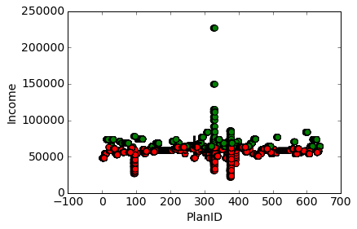
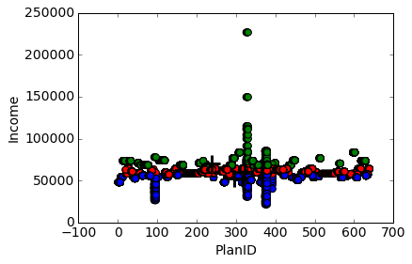
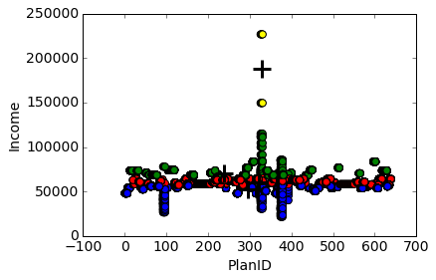
Model Results

Slide 12
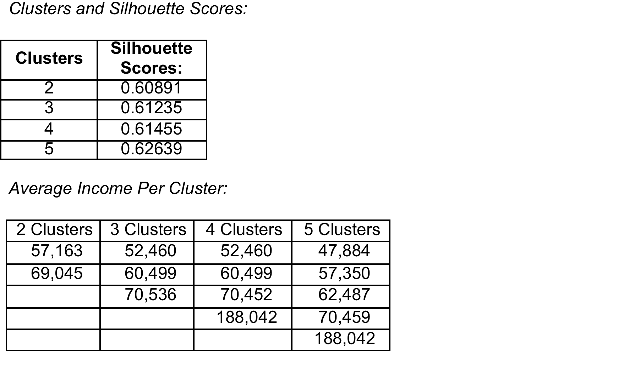
Model Results

Slide 13
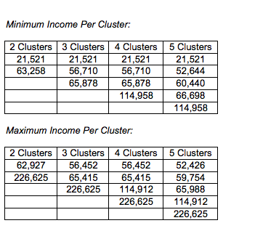
Model Results

Slide 14
Business Applications and Conclusions
The purpose of study is useful to see what types of plans should be sold in different ZIP codes.
Corresponding how “rich” the benefits are for a particular plan to a certain income level, we could a better focus on how to sell individual and segment plans around the United States.

Slide 15
Business Applications and Conclusions
With the average income known about the plans sold to which ZIP codes, insurers can focus advertising on, or creating plans and networks that better suit these customers.
Looking at the range the clusters place the incomes with the corresponding richness of the plans would be a great marketing tactic.

Slide 16
Business Applications and Conclusions
Extra Time with Data and Model
I would add more plan features and use dimensionality reduction to see how I could improve the model.
More elements could be added to improve and make the model more robust such as Maximums, Deductibles, Individual v Family Rules, Multi-State Plans

